Slide 1
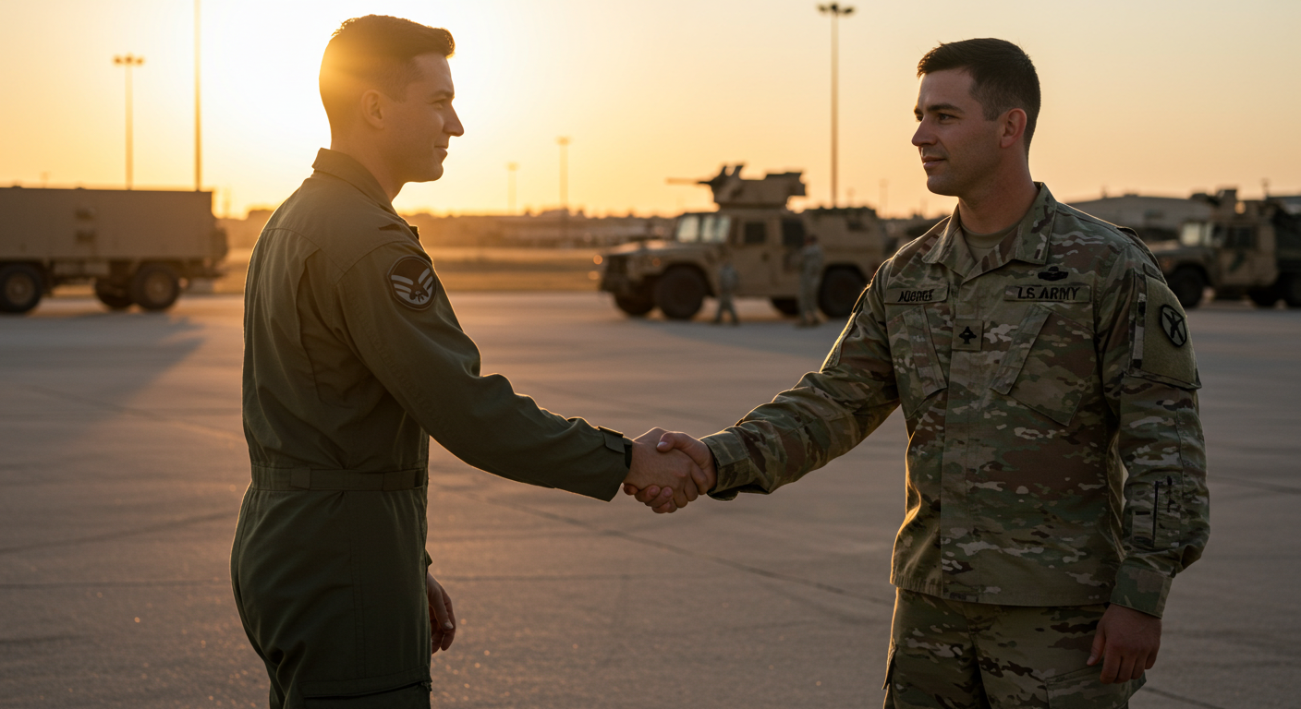
Using integrated primary prevention to reduce interpersonal violence and other harmful behaviors in the Michigan National Guard (MING)
Heather Nystrom MBA MSW BCD DCPPP-4, Deidre Barry MPH, Dave Davenport DCPPP-4, Joshua Twiest MA LLPC DPPP-3, Adam Lavigne MA DPPP-3, Ray Burley DPPP-3
Michigan National Guard Integrated Primary Prevention Workforce (IPPW), J9
How can the military apply the public health model to PREVENT interpersonal violence and other harmful behaviors?
Methodology
During the inception of the IPPW our team focused on engaging the field and educating leaders at all echelons and stakeholders about the program in effort to establish a prevention framework for the MING. IPPW leveraged military doctrine to ensure consistency in advising command teams. By integrating military processes with a public health framework, IPPW developed standardized procedures to enhance force readiness, lethality, and mission effectiveness. This initiative underscores the necessity of combining military doctrinal frameworks with prevention strategies to ensure sustainable and effective prevention when working with military populations.
Defense Organizational Climate Survey - DEOCS
The DEOCS is a primary tool for the IPPW in assessing organizational climate. The IPPW collected data from the DEOCS on the risk and protective factors related to attitudes, beliefs, and behaviors linked to Interpersonal Violence and other harmful behaviors. Our most significant participation indicator was the DEOCS completion percentage, which increased from 51% to 58%.
Introduction
The Michigan National Guard (MING) Integrated Primary Prevention Workforce (IPPW) helped the military cultures of the Michigan Air and Army National Guard begin to understand public health by using the language of military training, procedures, and policies. The buy-in from the highest leadership paved the way to collect data and work at the lowest levels to begin implementing an adapted public health model. The focus in the initial stages has been to increase participation in the DEOCS survey and leadership engagement at all MING levels. The data shows a modest increase in survey completion, indicating increased participation. The IPPW has also increased the number of Command Climate Assessments (CCAs), showing increased engagement. Also included is the data showing a slight positive trend between the last two Defense Organizational Climate Surveys across the surveyed risk and protective factors for the state and compared to many of the National Guard Bureau (NGB) averages.
MING DEOCS
Completion Percentage
Integration of Air Force and Army prevention
IPPW ensured a consistent, standardized approach in advising command teams by leveraging existing joint military doctrine. The initiative aligns with the Department of Defense's prevention plan and the 2022 National Defense Strategy (joint Air Force and Army documents), reinforcing a whole-of-person and whole-of-community approach to strengthening force readiness and mission effectiveness. Working jointly with the Air Force and Army units in Michigan allows the IPPW to suggest best prevention practices to leadership and bring their best practices back to Michigan's units. Sharing best practices between the Army and Air Force improves MING's readiness to deploy and retain Service members.
DEOCS Protective Factors
Factors | FY24 | FY23 | NGB
Supportive Leader | 87% | 85% | 87%
Firearms Stored | 82% | 81% | 81%
Cohesion | 80% | 77% | 77%
Transformational Leader Non-Commissioned Officers | 79% | 74% | 75%
Transformational Leader Officers | 77% | 74% | 75%
Inclusion | 77% | 75% | 76%
Engaged & Committed | 73% | 75% | 76%
Connectedness | 79% | 79% | 79%
Work-life Balance | 67% | 67% | 71%
Fair Treatment | 66% | 64% | 80%
Morale | 52% | 50% | 53%
DEOCS risk factors of all Service Members in the MING for FY23 and FY24 compared to the NGB average from FY 23 (higher is better)
2024 Combined MING DEOCS Statistics
DEOCS Risk Factors
Factors | FY24 | FY23 | NGB
Stress | 34% | 35% | 33%
Racially Harassing Behaviors | 16% | 17% | 17%
Sexually Harassing Behaviors | 16% | 17% | 15%
Passive Leadership Non-Commissioned Officers | 13% | 15% | 15%
Passive Leadership Officers | 15% | 17% | 18%
Sexist Behaviors | 9% | 10% | 9%
Workplace Hostility | 10% | 12% | 12%
Toxic Leader Immediate Supervisor | 7% | 8% | 9%
Toxic Leader Non-Commissioned Officers | 5% | 6% | 6%
Binge Drinking | 4% | 5% | 4%
Alcohol Impaired Memory | 1% | <1% | 1%
DEOCS risk factors of all Service Members in the MING for FY23 and FY24 compared to the NGB average from FY 23 (lower is better)
Penny serves in MING with Adam Lavigne, a chaplain and IPPW prevention specialist.
She is trained and certified through
Puppies Behind Bars, New York, and
accredited through Assistance
Dogs International​. Penny
helps to reduce stress
and increase feelings
of well-being among
MING Service members​.
She is very popular
and had 407
Service Member
contacts in Q1 of
FY25
alone.​
Michigan National Guard
8771 Participating Service Members
108
Participating Organizations
CCA Completions
Command Climate Assessment (CCA)
The Command Climate Assessment (CCA) enables leadership to understand their DEOCS data and to build an action plan to prevent interpersonal violence and other harmful behaviors. Once leaders understand their organization’s risk and protective factors, they can select evidence-based training, procedures, and policies with the support of the IPPW and other helping programs. The IPPW has met its leadership engagement goals by increasing the number of CCAs from last year of 67 to reach 96 completions this year.
2024 Combined MING DEOCS Statistics
Conclusion
IPPW's work highlights the necessity of integrating military strategic goals with a public health approach to prevention. The use of doctrine-driven processes ensures that prevention programs and interventions are evidence-based and operationally relevant. As the military continues to address harmful behaviors that impact personnel and overall effectiveness, BFCs and Command Climate Assessments' success provides a model for sustainable, proactive prevention efforts. Continued refinement and expansion of these initiatives will be critical in fostering a resilient and mission-ready force.
FY 24
FY 23
Battlefield Circulations (BFC)
MING IPPW saw a need to add qualitative data to
the quantitative of the DEOCS survey to gain clarity
Regarding risk and protective factors. IPPW staff
utilized windshield and walking surveys, interviews,
and group discussions. IPPW renamed these qualitative data collection efforts "Battlefield Circulations (BFC)" for a military context. The IPPW also develops customized questions for each event with unit leadership input before each BFC to ensure the quality of the evaluation. Utilization of existing doctrine allowed for known and consistent application in assessing a unit and aiding in a commander's decision-making.
Joint Integration
PREVENTION of Interpersonal Violence and other Harmful Behaviors
2024 Combined MING DEOCS Statistics
+
For paper, contact information, and references
DEOCS CCAs BFCs
=
+
Engagement and Participation

